Slide 1



Quick Sort Algorithm

Slide 2
top = NULL
2 if (n > 1) then
top = top+1
lower[top] = 0
upper[top] = n-1
endif
3 while(top!=NULL)
(a) beg = lower[top]
(b) end = upper[top]
(c) top = top – 1
(d) quick(a, n, beg, end, loc)
(e) if(beg < loc – 1) then
top = top+1
lower[top] = beg
upper[top] = loc – 1
endif

Slide 3
if( loc + 1 < end) then
top = top+1
lower[top] = loc + 1
upper[top] = end
endif
endwhile
4. Return
5. STOP
quick(a, n, beg, end, loc) - Sub-algorithm
1. left = loc = beg, right = end
2. while(a[loc] <= a[right] and loc!= right)
right = right – 1
endwhile

Slide 4
if(loc = right) then
return
endif
4. if(a[loc] > a[right]) then
swap a[loc] and a[right]
loc = right
endif
5. while(a[left] <= a[loc] and left!= loc)
left = left + 1
endwhile
6. if(loc = left) then
return
endif
7. if(a[left] > a[loc]) then
swap a[left] and a[loc]
loc = left
goto step2
endif
8. Return
9 STOP

Slide 5
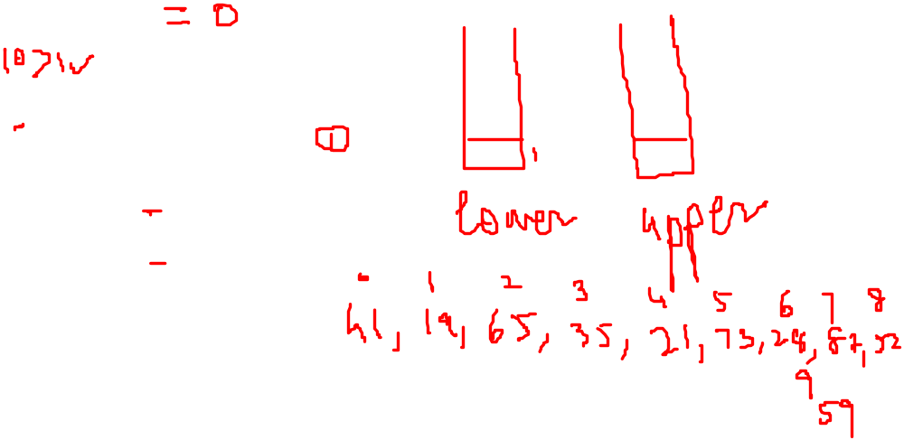
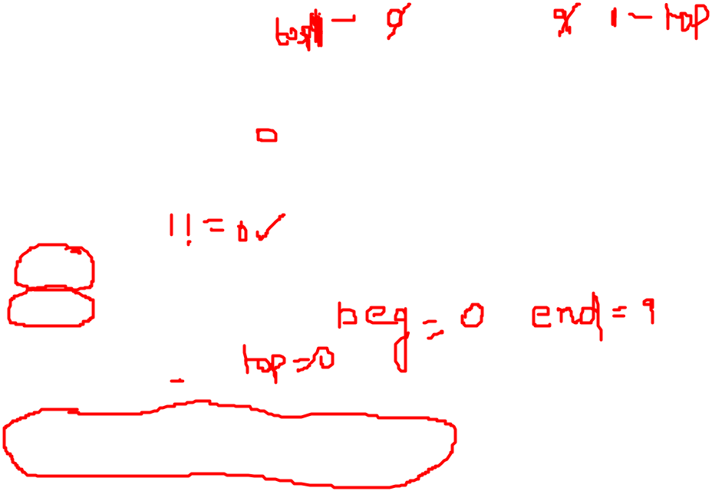
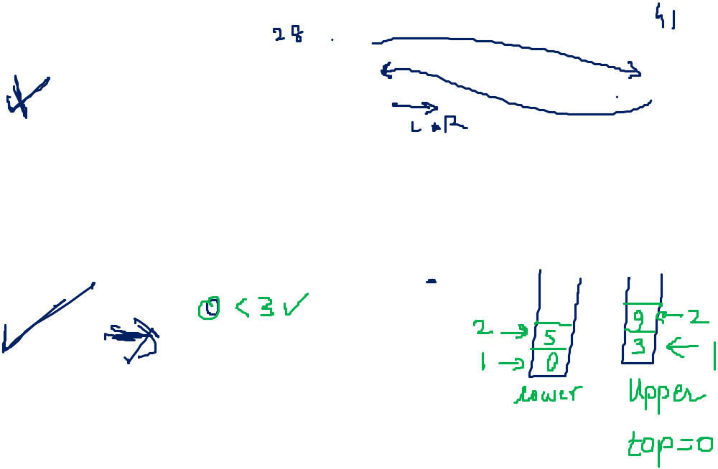
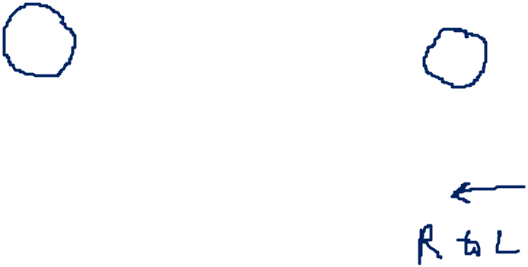
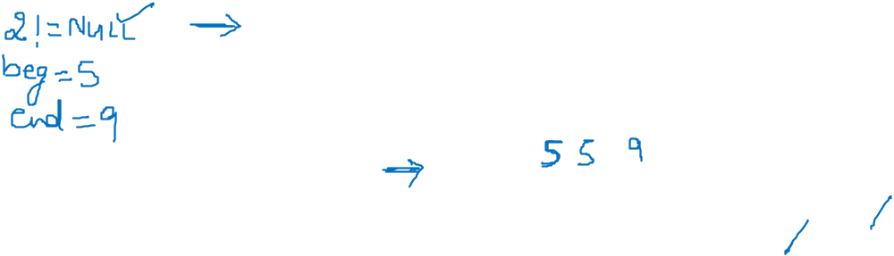


Quick Sort Algorithm
top = NULL
2 if (n > 1) then
top = top+1
lower[top] = 0
upper[top] = n-1
endif
3 while(top!=NULL)
(a) beg = lower[top]
(b) end = upper[top]
(c) top = top – 1
(d) quick(a, n, beg, end, loc)
(e) if(beg < loc – 1) then
top = top+1
lower[top] = beg
upper[top] = loc – 1
endif

Slide 6
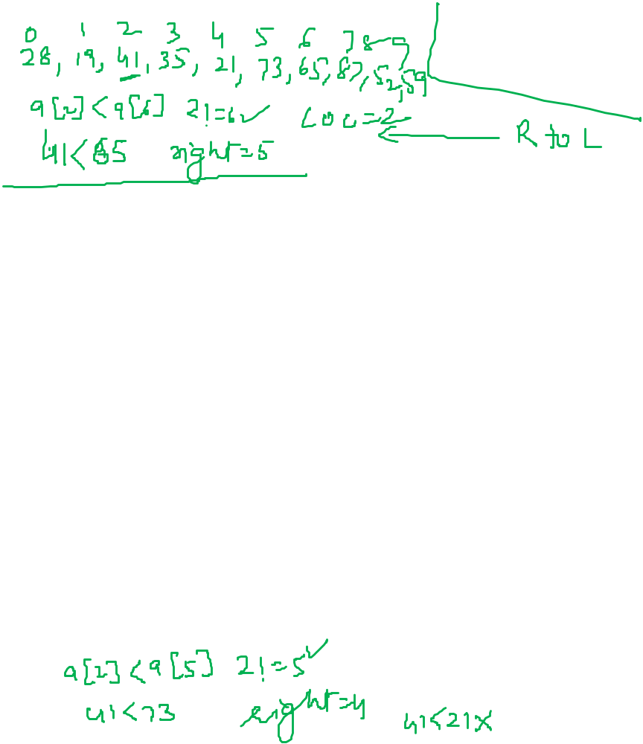
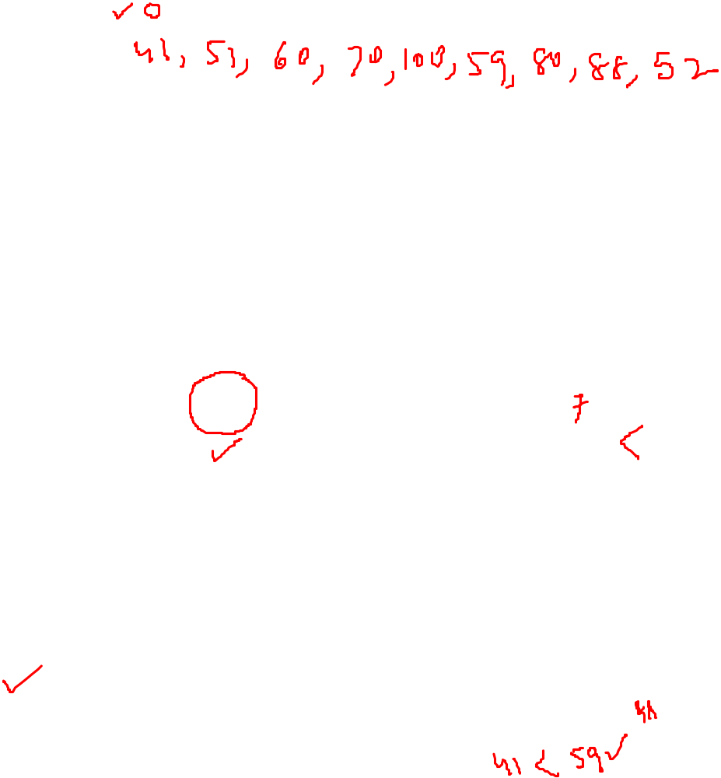

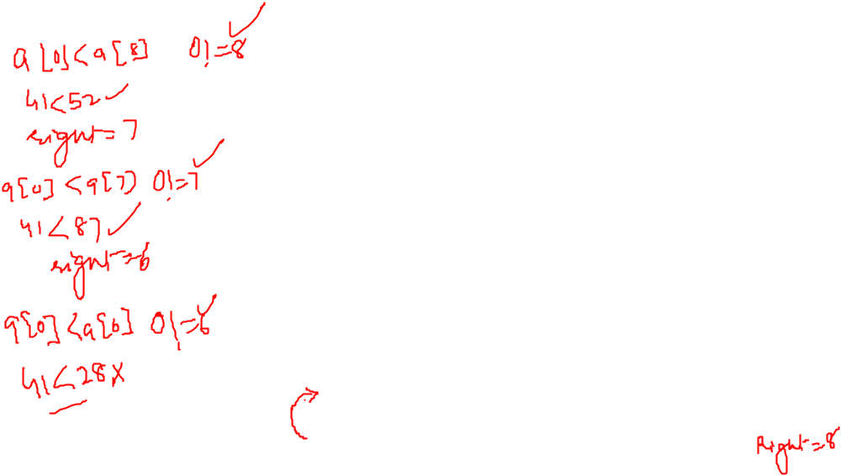
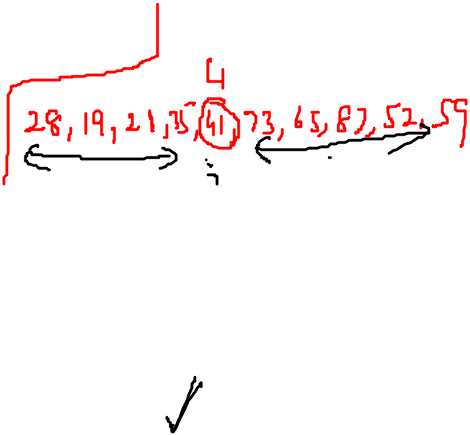
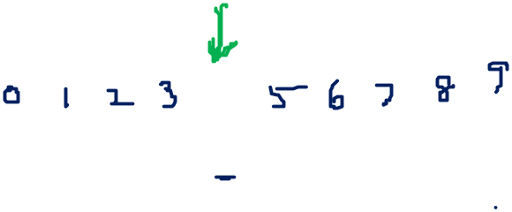

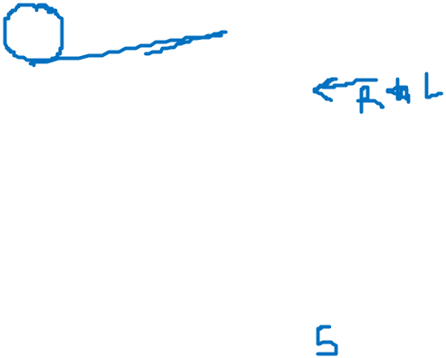
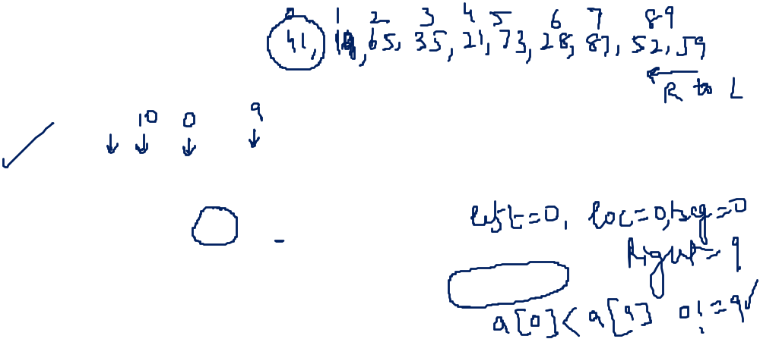
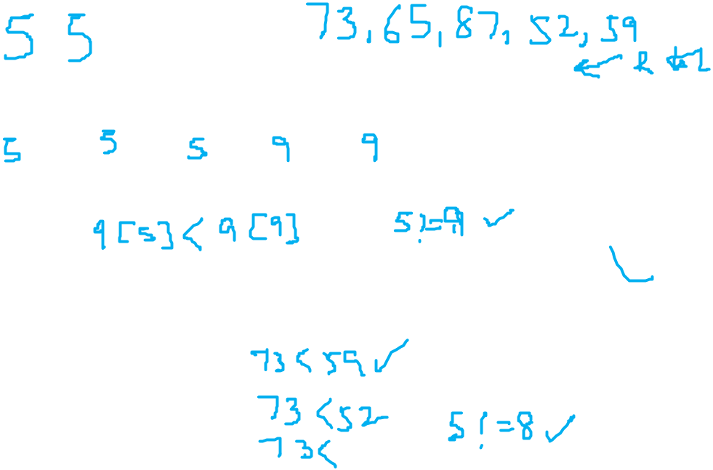
(f) if( loc + 1 < end) then
top = top+1
lower[top] = loc + 1
upper[top] = end
endif
endwhile
4. Return
5. STOP
quick(a, n, beg, end, loc) - Sub-algorithm
1. left = loc = beg, right = end
2. while(a[loc] <= a[right] and loc!= right)
right = right – 1
endwhile

Slide 7
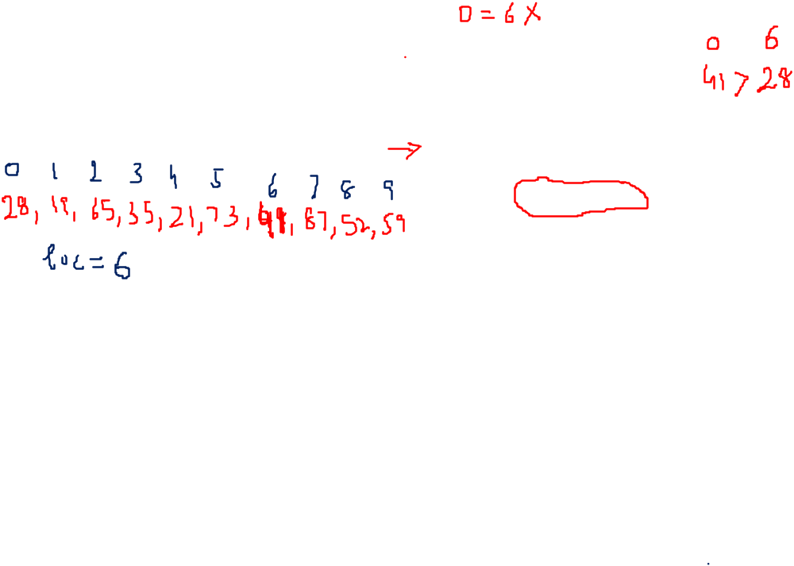

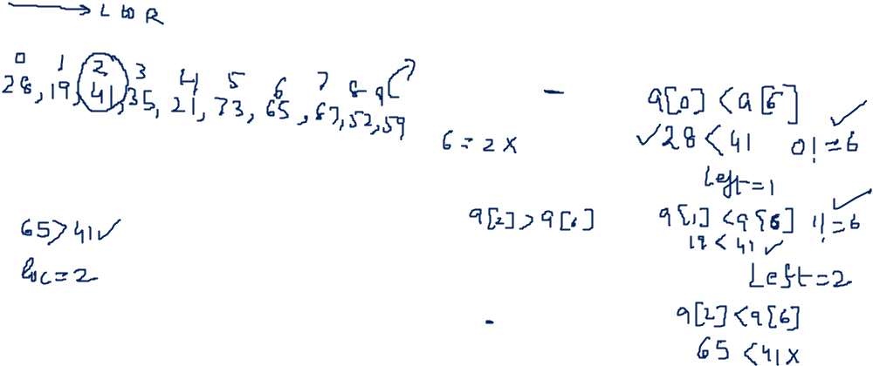
3. if(loc = right) then
return
endif
4. if(a[loc] > a[right]) then
swap a[loc] and a[right]
loc = right
endif
5. while(a[left] <= a[loc] and left!= loc)
left = left + 1
endwhile
6. if(loc = left) then
return
endif
7. if(a[left] > a[loc]) then
swap a[left] and a[loc]
loc = left
goto step2
endif
8. Return
9 STOP

Slide 8
